Slide 1


KASHI
UNFOLD
By: Aman Singh
Ayush Keshari
Chetna Yadav

Slide 2


INDEX
Aim of Project
Technical Features
About banaras
About the Website
Feaures of the Website

Slide 3
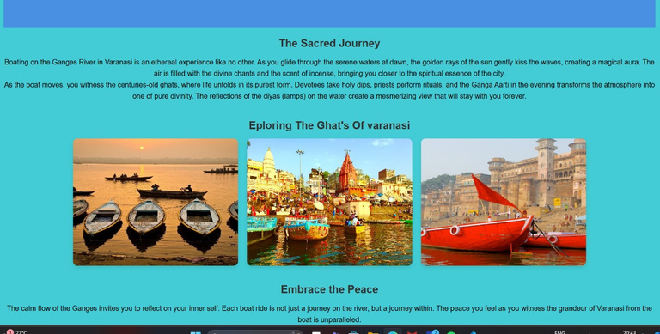
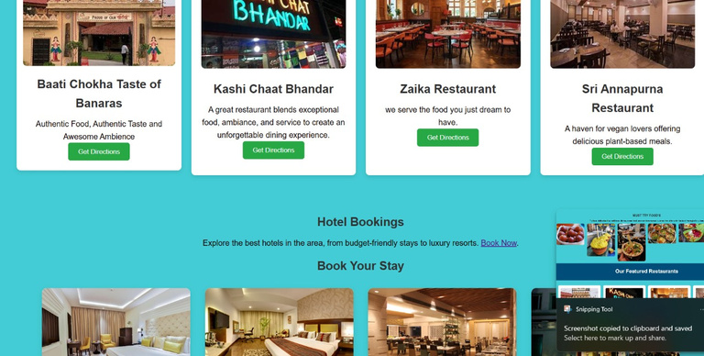


Kashi
Unfold
A website that we have developed to give you a glimpse of varanasi, a tour guide your friend to keep you company in city of Lord Shiva and the City of Ganges.

Slide 4
Aim of the Project
The aim of the Kashi Unfold website is to provide a user-friendly platform that simplifies travel planning for visitors to Varanasi. It seeks to offer comprehensive information on accommodations, famous attractions, and transportation options, ensuring that travelers can effortlessly explore the city's spiritual, cultural, and historical landmarks. The website’s goal is to enhance the visitor experience by helping them make informed decisions, create personalized itineraries, and enjoy a hassle-free journey through the sacred and vibrant city of Banaras.

Slide 5




Technical Features
Technical Features of the Website:
Frontend:
HTML: Structures the content and layout of the website, organizing text, images, links, and other elements.
CSS: Styles the appearance of the website, including colors, fonts, layout, and responsiveness for a visually appealing design.
Backend:
JavaScript: Handles server-side logic, processes user requests, and manages dynamic content, ensuring smooth functionality and interaction between the frontend and backend.

Slide 6

About Banaras
Banaras, also known as Varanasi or Kashi, is a revered spiritual city and one of the oldest continuously inhabited places in the world.
Often called the "City of Temples," it is home to thousands of shrines and temples, with the Kashi Vishwanath Temple dedicated to Lord Shiva being the most prominent.
Banaras holds immense religious significance in Hinduism as it is believed to be Lord Shiva's abode, where the cycle of life and death meets spiritual liberation.
Located on the sacred banks of the Ganges River, the city attracts millions of pilgrims and tourists seeking divine blessings and spiritual enlightenment.

Slide 7
About the Website
The Kashi Unfold website is a comprehensive platform designed to help travelers plan their trip to Varanasi with ease. It offers a curated selection of hotels, ranging from luxury to budget-friendly, allowing users to find the ideal place to stay. The site also provides a list of famous attractions, including temples, ghats, and historical sites, along with helpful travel tips. Additionally, it offers information on local transportation options, ensuring smooth navigation through the city. Whether you're seeking accommodation, sightseeing, or transport advice, this website simplifies your Varanasi travel experience.
4o

Slide 8
Features of the Website
Choose Your Hotel: Browse through a wide range of accommodation options, from luxury hotels to budget stays. Each listing provides detailed information on amenities, prices, and guest reviews, helping you find the perfect place to stay based on your preferences and budget.
Explore Famous Places: Discover the must-visit spots in Varanasi, including the Kashi Vishwanath Temple, Dashashwamedh Ghat, Sarnath, and more. Our site offers insights into each location, including historical significance, visiting hours, and tips to make the most of your visit.
Transportation Options: Whether you're looking for local transport, private cabs, or guided tours, we provide detailed information on how to navigate the city. From tuk-tuks to riverboats, find the best way to travel and explore Varanasi’s narrow lanes and bustling ghats.
With the Banaras Travel Guide website, you can easily plan your trip, choose your stay, and explore the spiritual and cultural richness of Varanasi, all in one place!

Slide 9
Thank you

